Slide 1
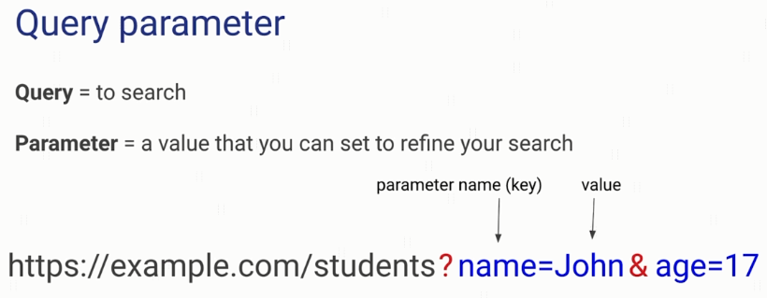

What are Query Parameters?

Slide 2
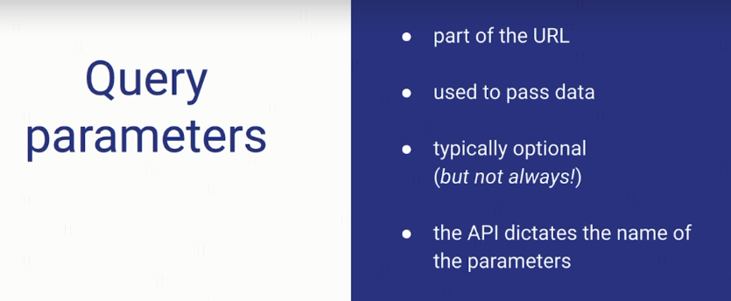
What are Query Parameters?

Slide 3
What are Query Parameters?
https://www.ecosia.org/search?q=actor
https://jobs.github.com/api

